Slide 1



Crop and Fertilizer Recommendation System in ML
By- ZAKKIUDHEEN.S
At- VELS UNIVERSITY

Slide 2

Learning Objectives
• Understanding the role of ML in agriculture
• Exploring datasets for crop and fertilizer prediction
• Implementing ML models for recommendation
• Evaluating model performance
GOAL
Source :
www.freepik.com/

Slide 3
Tools and Technology used
• Programming: Python
• Libraries: Pandas, NumPy, Scikit-learn,Matplotlib,Seaborn
• Development: Jupyter Notebook
• Datasets: Crop Recommendation & Fertilizer Prediction

Slide 4
Methodology
1. Data Collection: Crop & fertilizer datasets
2. Data Preprocessing: Cleaning, normalization
3. Model Selection: Decision Trees, Random Forest, etc.
4. Training & Evaluation: Accuracy & performance tuning
5. Deployment: Real-time recommendation system

Slide 5
Problem Statement:
1,Farmers struggle with selecting the right crops and fertilizers.
2,Soil conditions, weather, and nutrient levels affect yield.
3,Lack of data-driven decision-making in traditional farming.
.
.

Slide 6
Solution:
1,A Machine Learning-based system that suggests the best crops and fertilizers based on soil parameters.
2,Helps improve yield and optimize resource usage.
3,Provides farmers with data-driven insights.

Slide 7
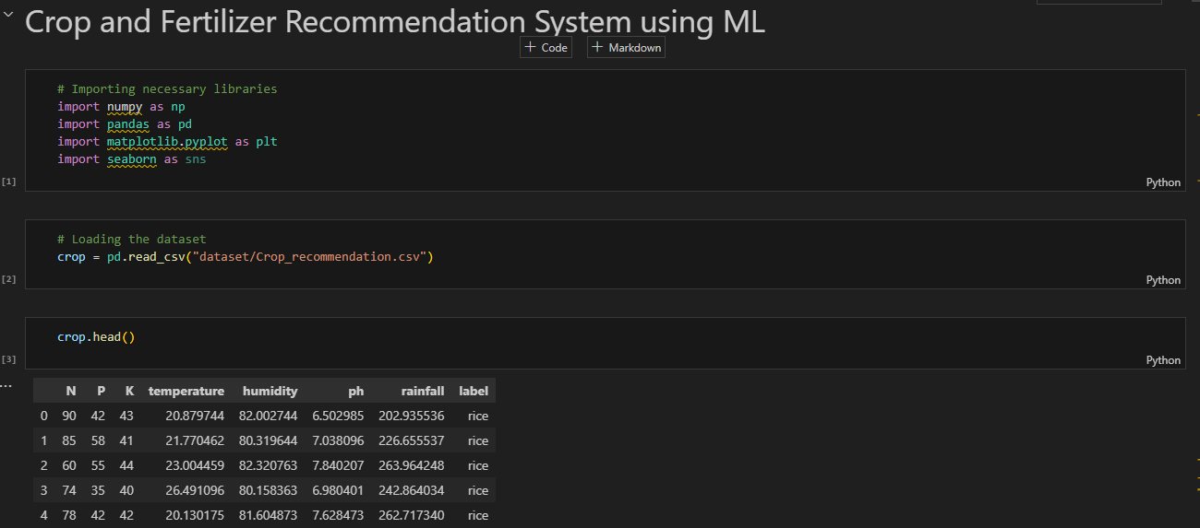
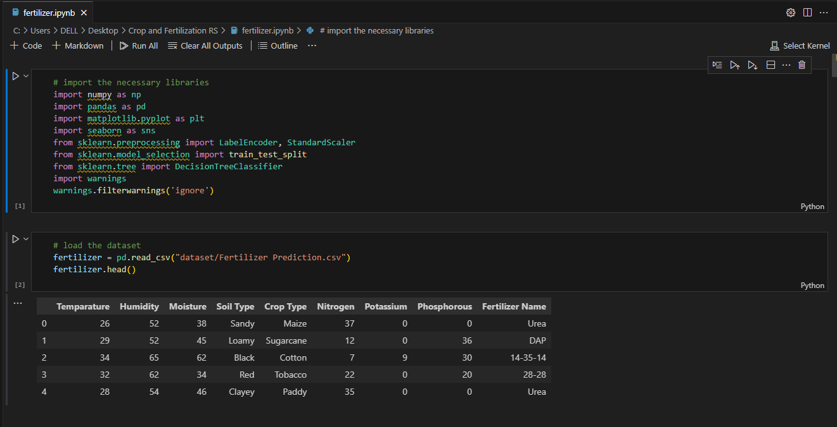
Screenshot of Output:

Slide 8
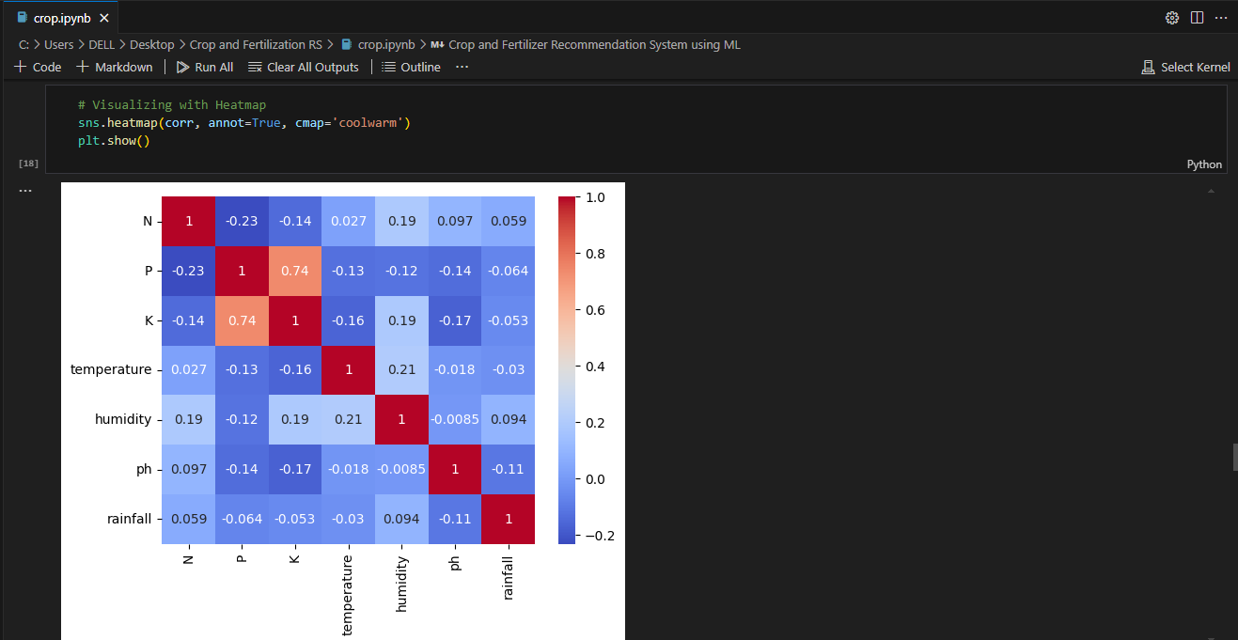
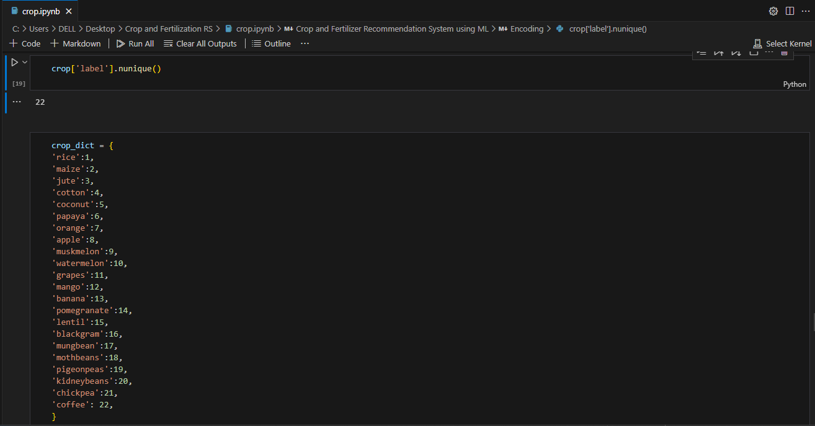
Screenshot of Output:

Slide 9
Conclusion:
1,ML can significantly enhance agricultural productivity.
2,Data-driven recommendations help farmers make informed decisions.
3,Future scope: IoT integration, real-time soil monitoring, and mobile app deployment.

